Slide 1
Hybrid Apps with .NET MAUI

Slide 2
What are hybrid apps and why build them?
Blend of native and web technology
Built using web tech (HTML, CSS, JavaScript) wrapped in a native app container
Access to native platform features and device hardware
Can mean mobile and/or desktop devices
Reach via app store distribution
Code reuse across device platforms and web browsers
Examples – Electron for desktop, Ionic for mobile
Notes:
Hybrid apps are a blend of both native and web solutions. The core UI of the application is written using web technologies such as HTML, CSS, and JavaScript. These apps are then wrapped in a lightweight native app "container" that allows them to leverage certain native platform features and device hardware (like a device's camera, contacts, push notifications, etc.) that a web application cannot access easily or even at all.
This approach allows hybrid apps to run on, for example, both iOS and Android platforms without the need for completely separate development. And they can be downloaded and installed through the app stores. The main advantage of hybrid apps is that they can achieve greater developer productivity via code reuse across devices and web browsers.
A couple examples are Electron for desktop apps and Ionic for mobile apps.

Slide 3


.NET MAUI
One Base Class Library
Type Unification
CLI Support
SDK Style Projects
Modern Support Lifecycle
Unified .NET
.NET
.NET MAUI
Mobile, desktop, hybrid
Android
iOS
WinUI
Mac Catalyst
WebView
WinUI
Mac
Catalyst
iOS
Android
Single Project
Microsoft.Extensions
.NET Hot Reload
XAML Hot Reload
Visual Diagnostics
Productive development
macOS
iOS
Notes:
.NET MAUI aims to help you build for all of these native platforms with one codebase and single project system.
Under the hood it uses native technologies that are out there today for building native apps. .NET MAUI abstracts all those frameworks into a single framework built on .NET. .NET MAUI lets web developers build hybrid web apps too.

Slide 4



.NET offers choice for developers
BLAZOR
BLAZOR + .NET MAUI
.NET MAUI
C#, HTML, CSS
C#, XAML
Reach
Depth
Websites and PWAs
Hybrid
Native
Notes:
So what does this look like with .NET? First of all, you have choices with client apps, the route you take depends on whether you want the most reach or the deepest native experiences.
<CLICK>
For reach we have the web and there’s Blazor. Blazor lets you build, fast, robust and secure web apps quickly with C#.
<CLICK>
Then there’s .NET MAUI which lets you build cross-platform native desktop and mobile apps with a single codebase.
But it’s a sliding scale.
<CLICK>
Depending on your application’s needs, you can choose the right mix for you. Fully web for the most reach, fully native for the richest native experiences, or a little bit of both with hybrid.
Today we’re going to show you how you can build apps that target both web and native with the most code reuse.

Slide 5
Blazor hybrid apps
Native app container & embedded controls
Fully native web UI through platform WebView
Multi-platform with MAUI abstractions
No internet required
Store distribution and reach
Blazor
.NET
Razor Components
BlazorWebview
.NET MAUI
WinUI
Mac
Catalyst
iOS
Android
macOS
iOS
Notes:
So what do we mean when we say Blazor hybrid apps?
With .NET MAUI, Blazor apps can now also run natively on devices. This means you can create hybrid client apps, which combine Blazor & MAUI components together into a single NATIVE client application, giving you full access to the native platform capabilities.
Blazor hybrid relies on .NET MAUI for a native application container and native controls, if you want to use them. So you could even mix Web UI with XAML UI if you want.
Blazor hybrid apps are built on top of .NET MAUI. You host Blazor components with the BlazorWebview with derives from the native platform’s WebView (i.e. WebView2 on Windows). No internet is required, UI is packaged with the app.
Blazor hybrid apps have full access to the MAUI abstractions and the native devices. You can do things like call native API's, access the file system, make phone calls, whateva!

Slide 6
Reusing UI across native and web
Web
Native
Blazor web app
BlazorApp1
BlazorApp1.Client
Blazor hybrid app
MauiApp1
Shared UI & Interfaces
Razor class library
RazorClassLibrary1
.NET
Razor Components
Notes:
If you also want to target web browsers, you can structure your solution to maximize code reuse using a shared Razor Class Library that houses the shared UI as well as interfaces of the services you want to call from the UI. The implementations of these are then defined in the specific Blazor Web and Blazor hybrid projects.

Slide 7
Demos
Notes:
Alright let’s get to some demos!
Eilon – File New Project - .NET MAUI Blazor hybrid app. (5-6 minutes)
- Quick tour of the new template in .NET 8.
- Show .csproj with multitargeting, platform specific folders, static web content in wwwroot
- Add Blazor Web App – talk about global rendering mode
- Add Razor Class Library
- Add Project references and consume component in both
- F5 to Windows & Web
Beth – TimeUntil app (6-7 minutes)
- Tour of structure of app
- Run Web app and show new Interactive Auto render mode
- Show interfaces and MAUI abstractions (DeviceInfo, Storage.Preferences)
- Targeting specific platforms (pre-processor directives/multi-targeting RCL, MAUI.MediaPicker API)
- Show in action on Android device - take selfie
- Mention WSA as debug target

Slide 8
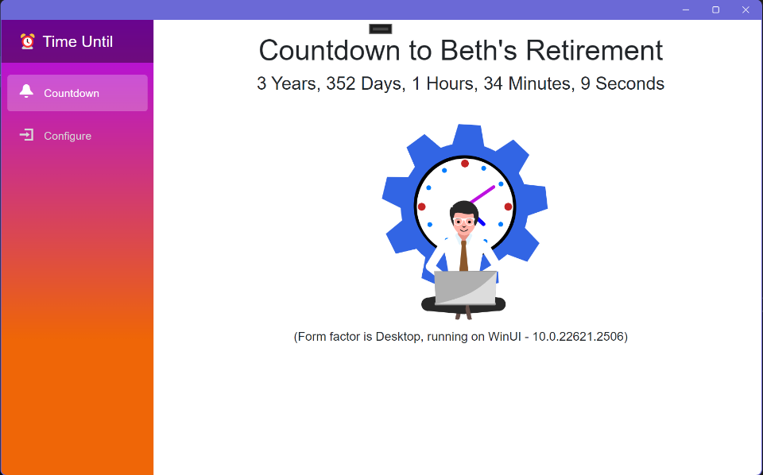
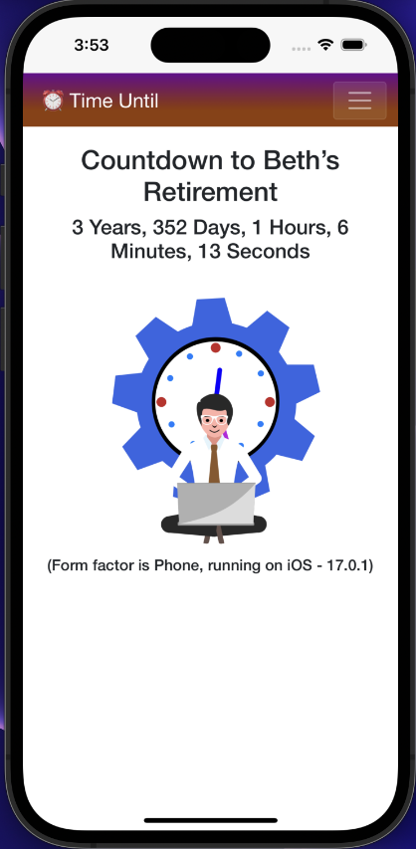

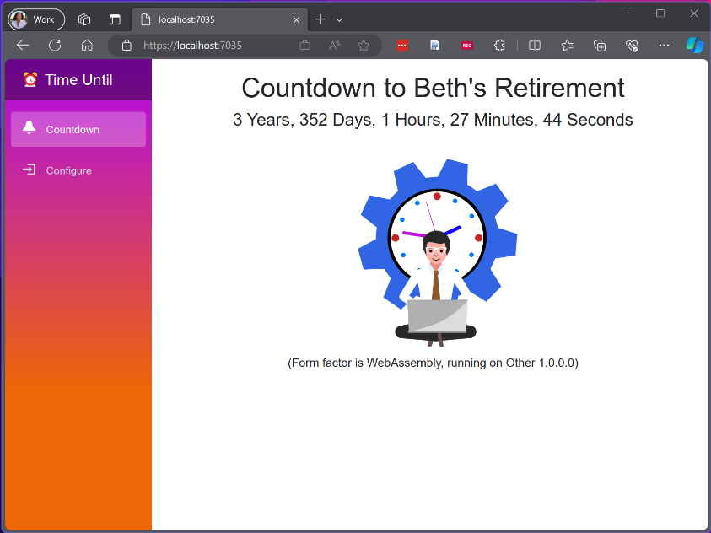


Slide 9
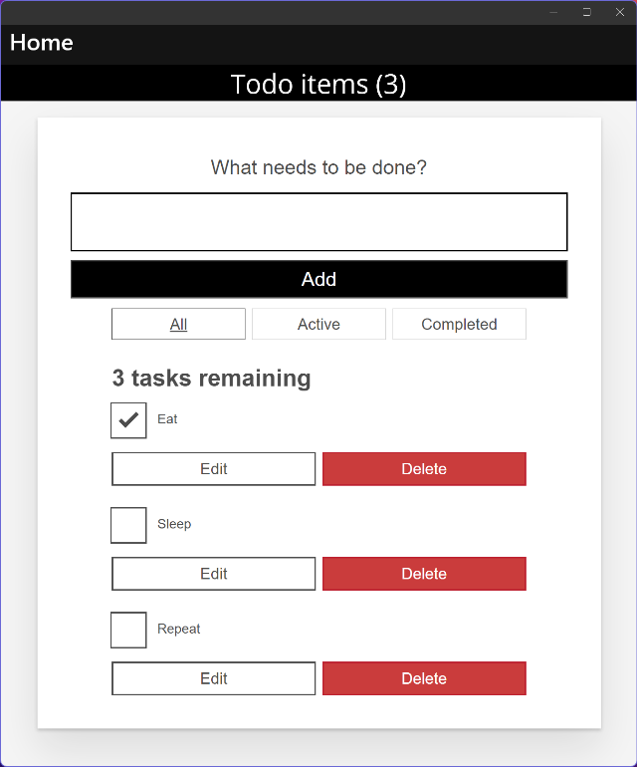
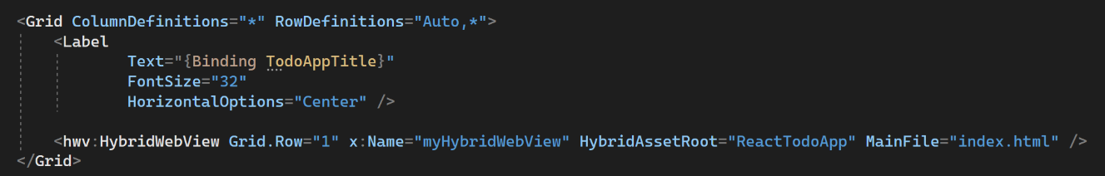
.NET MAUI HybridWebView Experiment
Multi-platform control based on .NET MAUI WebView
Host static web assets (HTML, JS, CSS, etc.)
Communicate between JavaScript & .NET
Reuse your Angular, React, etc. investments in MAUI native desktop and mobile apps
Use any web-based UI and it can interact with C# code
Looking for feedback!
github.com/Eilon/MauiHybridWebView
MAUI C#
Native app container & controls
Hybrid WebView React JS
Notes:
Finally, we want to let you know ab out what we’re thinking for the future.
We’re investigating whether we should bring more than just Blazor to hybrid apps with MAUI.
The HybridWebView experiment is about bringing any web-based UI into MAUI apps.
We’ve spoken to a lot of customers that have investments in Angular or React or other web frontend technologies and they want to be able to reuse them in MAUI.
In this example, the HybridWebview is hosting a React JS “Todo” app and C# is providing the data to it. It’s also interacting with native MAUI controls -- the Title at the top.
You can use the HybridWebView in Windows, Mac, iOS and Android, just like MAUI!
Like any hybrid app, there’s no web server, no http, no internet needed
And to introduce you to this tech, the mastermind behind it, Eilon!
Eilon – MAUI HybridWebView (3-5 minutes)
- Show repository, nuget package
- Start with a basic file new proj then show baked prebuilt Todo demo….?

Slide 10
Summary
Hybrid apps are great for web devs that want native platform capabilities & store distribution
Reuse web UI across your web apps and native apps with component libraries and interfaces
Use MAUI for multi-platform abstractions and multi-targeting

Slide 11

Resources
Get started with .NET MAUI and Blazor Hybrid learn.microsoft.com/aspnet/core/blazor/hybrid/tutorials/maui
Blazor Hybrid for Beginners Video Series aka.ms/dotnet/beginnervideos/youtube/blazorhybrid
Try the MAUI HybridWebView github.com/Eilon/MauiHybridWebView
Play with the sample app github.com/BethMassi/BethTimeUntil

Slide 12
Questions?

